Slide 1
Structural Design Patterns

Slide 2
Introduction
Structural design patterns are concerned with how classes and objects can be composed, to form larger structures.
The structural design patterns simplifies the structure by identifying the relationships.
These patterns focus on, how the classes inherit from each other and how they are composed from other classes.

Slide 3
Types of structural design patterns :
Structures
Adapter Pattern
Adapting an interface into another according to client expectation.
Bridge Pattern
Separating abstraction (interface) from implementation.
Composite Pattern
Allowing clients to operate on hierarchy of objects.
Decorator Pattern
Adding functionality to an object dynamically.
Facade Pattern
Providing an interface to a set of interfaces.
Flyweight Pattern
Reusing an object by sharing it.
proxy Pattern
Representing another object.

Slide 4
Adapter Class
An Adapter Pattern says that just "converts the interface of a class into another interface that a client wants".
In other words, to provide the interface according to client requirement while using the services of a class with a different interface.
The Adapter Pattern is also known as Wrapper.

Slide 5
Advantage of Adapter Pattern
It allows two or more previously incompatible objects to interact.
It allows reusability of existing functionality.

Slide 6
UML for Adapter Pattern:
Target Interface: This is the desired interface class which will be used by the clients.
Adapter class: This class is a wrapper class which implements the desired target interface and modifies the specific request available from the Adaptee class.
Adaptee class: This is the class which is used by the Adapter class to reuse the existing functionality and modify them for desired use.
Client: This class will interact with the Adapter class.

Slide 7
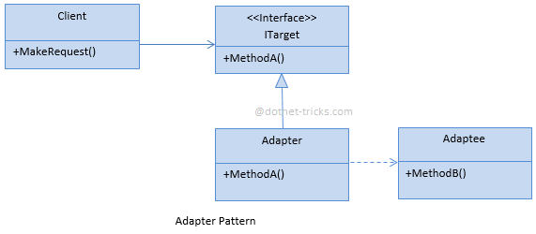

Slide 8
public interface IDownloader
{
byte[] Download(String fileName);
}
//Adaptee class
public class DownloaderApp
{
public byte[] DownloadResume(String fileName)
{
var downloader = getInstance<IDownloader>();
var file = downloader.Download(fileName);
return file;
}
}
//Adaptee class
public class GoogleDrive
{
public AuthToken Signin(){}
public Stream Download(AuthToken token,String fileName){}
}

Slide 9
//Adapter class
public class GoogleAdapter implements IDownloader
{
public byte[] Download(String fileName)
{
var drive = new GoogleDrive();
var token = drive.Signin();
var file = drive.Download(token,fileName);
return file.ToByteArray();
}
}
//client class
class Adapter
{
public static void main(String args[])
{
GoogleAdapter ga = new GoogleAdapter();
byte[] file = ga.Download(......);//file name
//sysout(file);
}
}

Slide 10

Bridge Pattern
Bridge Pattern enables the separation of implementation from the interface.
It improves the extensibility.
It allows the hiding of implementation details from the client.

Slide 11
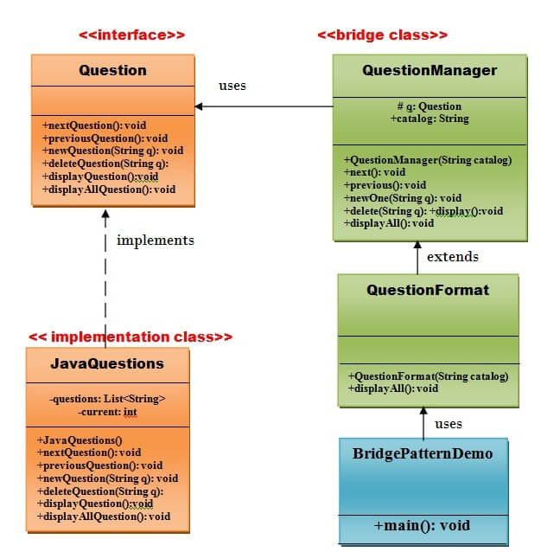

Slide 12
public interface Question {
public void nextQuestion();
public void previousQuestion();
public void newQuestion(String q);
public void deleteQuestion(String q);
public void displayQuestion();
public void displayAllQuestions();
}
//JavaQuestions implementation class that will implement Question interface.
public class JavaQuestions implements Question {
private List <String> questions = new ArrayList<String>();
private int current = 0;
public JavaQuestions(){
questions.add("What is class? ");
questions.add("What is interface? ");
questions.add("What is abstraction? ");
questions.add("How multiple polymorphism is achieved in java? ");
questions.add("How many types of exception handling are there in java? ");
questions.add("Define the keyword final for variable, method, and class in java? ");
questions.add("What is abstract class? ");
questions.add("What is multi-threading? ");
}

Slide 13
public void nextQuestion() {
if( current <= questions.size()-1 )
current++;
System.out.print(current);
}
public void previousQuestion() {
if( current > 0 )
current--;
}
public void newQuestion(String quest) {
questions.add(quest);
}
public void deleteQuestion(String quest) {
questions.remove(quest);
}
public void displayQuestion() {
System.out.println( questions.get(current) );
}
public void displayAllQuestions() {
for (String quest : questions) {
System.out.println(quest);
}
}
}

Slide 14
// Bridge class
//QuestionManager class that will use Question interface public class QuestionManager {
protected Question q;
public String catalog;
public QuestionManager(String catalog) {
this.catalog=catalog;
}
public void next() {
q.nextQuestion();
}
public void previous() {
q.previousQuestion();
}
public void newOne(String quest) {
q.newQuestion(quest);
}
public void delete(String quest) {
q.deleteQuestion(quest);
}
public void display() {
q.displayQuestion();
}
public void displayAll() {
System.out.println("Question Paper: " + catalog);
q.displayAllQuestions();
}
}

Slide 15
//QuestionFormat class that will extend the QuestionManager class
public class QuestionFormat extends QuestionManager {
public QuestionFormat(String catalog){
super(catalog);
}
public void displayAll() {
System.out.println("\n--");
super.displayAll();
System.out.println("----");
}
}
//main
public class Bridge {
public static void main(String[] args) {
QuestionFormat questions = new QuestionFormat("Java Programming Language");
questions.q = new JavaQuestions();
questions.delete("what is class?");
questions.display();
questions.newOne("What is inheritance? ");
questions.newOne("How many types of inheritance are there in java?");
questions.displayAll();
}
}

Slide 16
Composite Pattern
A Composite Pattern says that just "allow clients to operate in generic manner on objects that may or may not represent a hierarchy of objects".
Advantages :
It defines class hierarchies that contain primitive and complex objects.
It makes easier to you to add new kinds of components.

Slide 17
Components of Composite Pattern
Component
Declares interface for objects in composition.
Declares an interface for accessing and managing its child components.
Leaf
Represents leaf objects in composition. A leaf has no children.
Composite
Stores child component.
Implements child related operations in the component interface.
Client
Manipulates objects in the composition through the component interface.

Slide 18
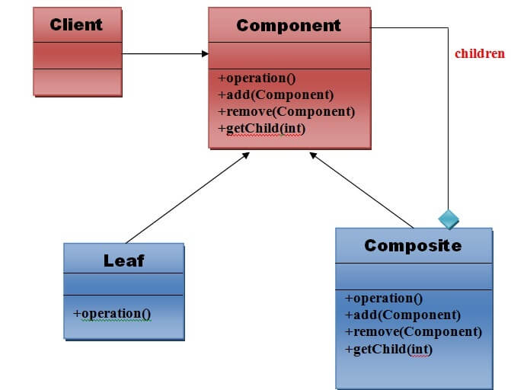

Slide 19
//composite example internal file system of computer
//(pictures , vedioes , subfolders)
public interface IFile
{
public double GetSize();
}
public class Folder
{
public List<Vedioes> vedioes = new List<Vedioes>();
public List<Pictures> pictures = new List<Pictures>();
public List<Folder> folders = new List<Folder>();
}

Slide 20
class Folder implements IFile{
private double calculateSize(Folder folder){
double total = 0;
foreach(picture : folder.Pictures)
total += picture.GetSize();
foreach(vedio : folder.vedioes)
total += vedio.GetSize();
foreach(folder : folder.Folder)
total += folder.GetSize();
return total;
}
public double GetSize(){
return calculateSize(this);
}
}
//main
public class Composite1 {
public static void main(String args[]){
galleryFolder.GetSize();
resume.GetSize();
}
}

Slide 21
Decorator Pattern
A Decorator Pattern says that just "attach a flexible additional responsibilities to an object dynamically".
In other words, The Decorator Pattern uses composition instead of inheritance to extend the functionality of an object at runtime.
The Decorator Pattern is also known as Wrapper.
Advantage of Decorator Pattern
It provides greater flexibility than static inheritance.
It enhances the extensibility of the object

Slide 22
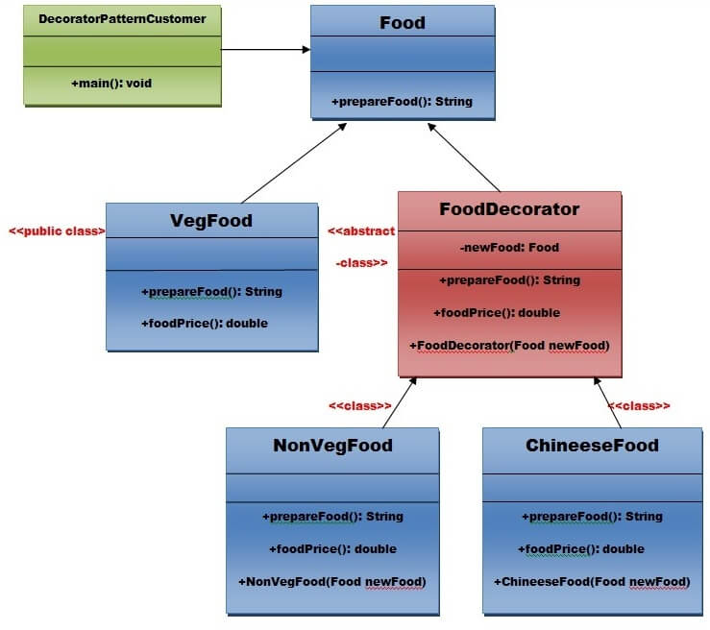

Slide 23
//decorator pattern
//Create a Food interface.
public interface Food {
public String prepareFood();
public double foodPrice();
}
//VegFood class that will implements the Food interface and override its all methods.
public class VegFood implements Food {
public String prepareFood(){
return "Veg Food";
}
public double foodPrice(){
return 50.0;
}
}

Slide 24
// FoodDecorator abstract class that will implements the Food interface and override
//it's all methods and it has the ability to decorate some more foods.
public abstract class FoodDecorator implements Food{
private Food newFood;
public FoodDecorator(Food newFood) {
this.newFood=newFood;
}
@Override
public String prepareFood(){
return newFood.prepareFood();
}
public double foodPrice(){
return newFood.foodPrice();
}
}

Slide 25
//NonVegFood concrete class that will extend the FoodDecorator class and override it's all methods
public class NonVegFood extends FoodDecorator{
public NonVegFood(Food newFood) {
super(newFood);
}
public String prepareFood(){
return super.prepareFood() +" With Roasted Chiken and Chiken Curry ";
}
public double foodPrice() {
return super.foodPrice()+150.0;
}
}

Slide 26
//ChineeseFood concrete class that will extend the FoodDecorator class and override it's all methods.
public class ChineeseFood extends FoodDecorator{
public ChineeseFood(Food newFood) {
super(newFood);
}
public String prepareFood(){
return super.prepareFood() +" With Fried Rice and Manchurian ";
}
public double foodPrice() {
return super.foodPrice()+65.0;
}
}

Slide 27
/Decorator class that will use Food interface to use which type of food customer wants means (Decorates).
public class Decorator {
private static int choice;
public static void main(String args[]) throws NumberFormatException, IOException {
do{
System.out.print("========= Food Menu ============ \n");
System.out.print(" 1. Vegetarian Food. \n");
System.out.print(" 2. Non-Vegetarian Food.\n");
System.out.print(" 3. Chineese Food. \n");
System.out.print(" 4. Exit \n");
System.out.print("Enter your choice: ");
BufferedReader br=new BufferedReader(new InputStreamReader(System.in));
choice=Integer.parseInt(br.readLine());
switch (choice) {
case 1:{
VegFood vf=new VegFood();
System.out.println(vf.prepareFood());
System.out.println( vf.foodPrice());
}
break;

Slide 28
case 2:{
Food f1=new NonVegFood((Food) new VegFood());
System.out.println(f1.prepareFood());
System.out.println( f1.foodPrice());
}
break;
case 3:{
Food f2=new ChineeseFood((Food) new VegFood());
System.out.println(f2.prepareFood());
System.out.println( f2.foodPrice());
}
break;
default:{
System.out.println("Other than these no food available");
}
}//end of switch
}while(choice!=4);
}
}

Slide 29
Facade Pattern
A Facade Pattern says that just "just provide a unified and simplified interface to a set of interfaces in a subsystem, therefore it hides the complexities of the subsystem from the client".
Usage of Facade Pattern:
When you want to provide simple interface to a complex sub-system.
Advantage of Facade Pattern
It shields the clients from the complexities of the sub-system components.

Slide 30
Flyweight Pattern
A Flyweight Pattern says that just "to reuse already existing similar kind of objects by storing them and create new object when no matching object is found".
Advantage of Flyweight Pattern
It reduces the number of objects.

Slide 31
//flyweight (intrinsic , extrinsic properties )
interface University{
public final String uname = "university_name";
}
class Student implements University{
private int id;
Student(int id)
{
this.id = id;
}
void display(){
System.out.println(uname + " " + id);
}
}
class Flyweight
{
public static void main(String args[])
{
Student s1= new Student(1);
Student s1= new Student(1);
s1.display();
s2.display();
}
}

Slide 32
Proxy Pattern
Proxy means an object representing another object.
Proxy Pattern "provides the control for accessing the original object".
So, we can perform many operations like hiding the information of original object, on demand loading etc.
Proxy pattern is also known as Placeholder.
Advantage of Proxy Pattern
It provides the protection to the original object from the outside world.

